Slide 1
Laser Cooling by Sawtooth Wave Adiabatic Passage
arXiv:1806.02931, arXiv:1707.01944
Huan Bui
ZGS – August 26th, 2022

Slide 2
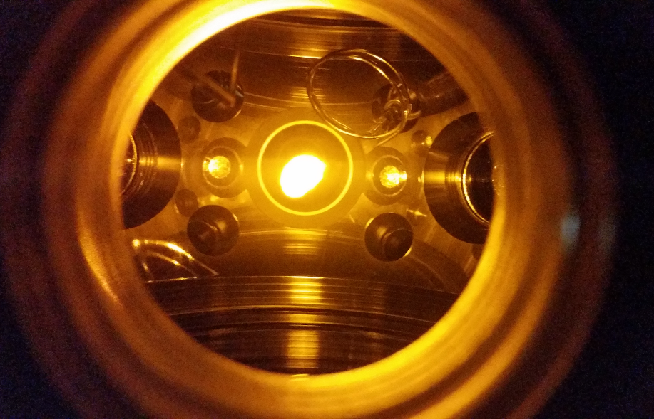
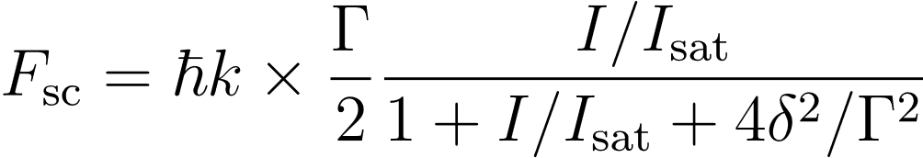
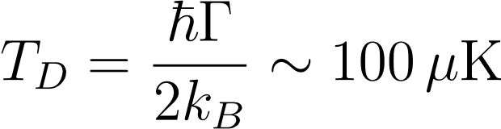
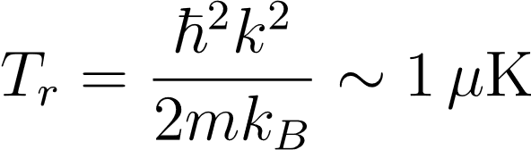
Laser cooling
Scattering force + Doppler effect:
Cooling limits:

Slide 3
Laser cooling
Scattering force + Doppler effect:
Cooling limits:

Slide 4
Laser cooling
Scattering force + Doppler effect:
Cooling limits:
sub-Doppler cooling: Sisyphus, Raman, VSCPT
Lower cooling limit?

Slide 5
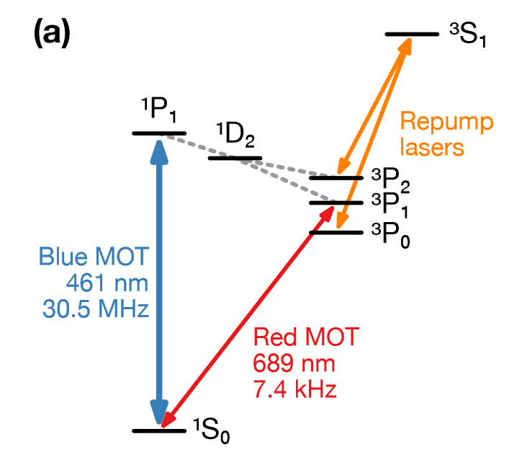

Laser cooling
Scattering force + Doppler effect:
Cooling limits:
sub-Doppler cooling: Sisyphus, Raman, VSCPT
Lower cooling limit?
Narrow linewidth transitions

Slide 6
Laser cooling
Scattering force + Doppler effect:
Cooling limits:
sub-Doppler cooling: Sisyphus, Raman, VSCPT
Lower cooling limit?
Narrow linewidth transitions
+ High capture range?
SWAP cooling?

Slide 7
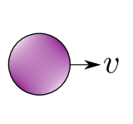
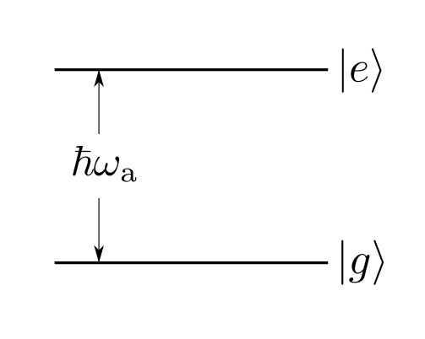
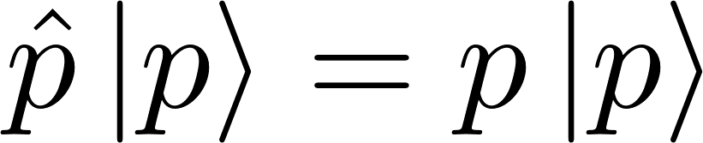
Basic mechanism

Slide 8
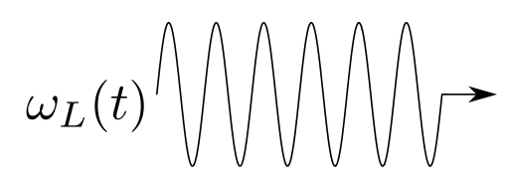
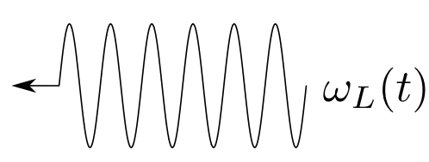
Basic mechanism

Slide 9
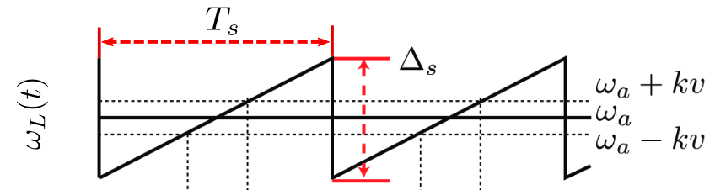
Basic mechanism

Slide 10


Basic mechanism

Slide 11
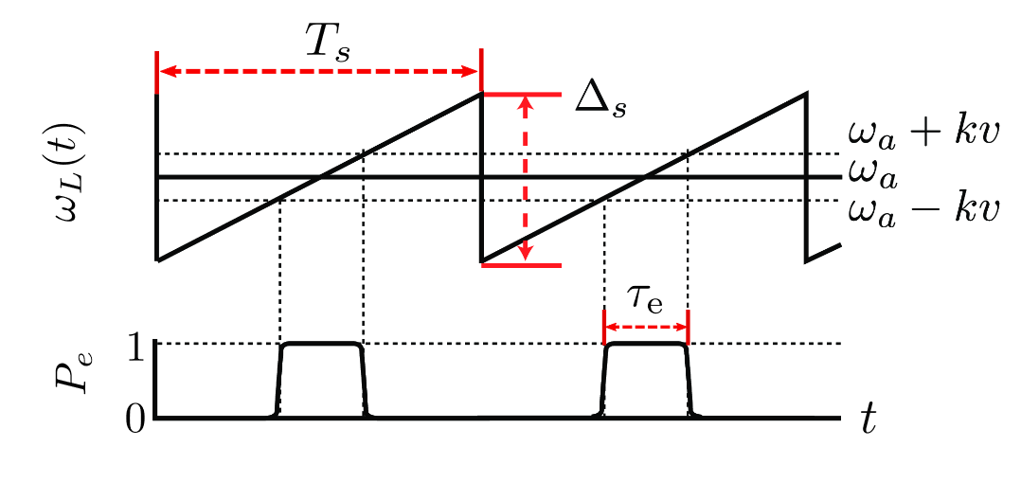
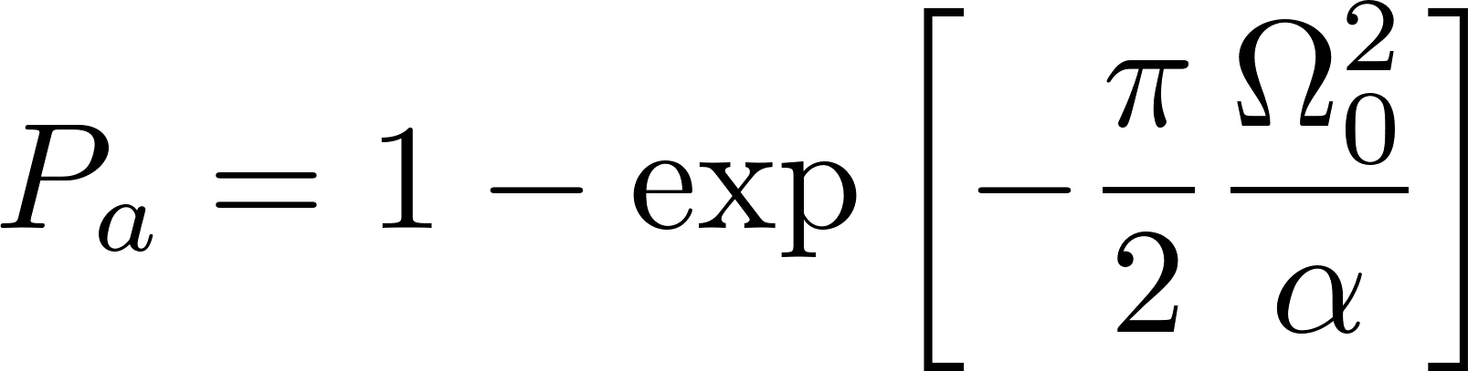
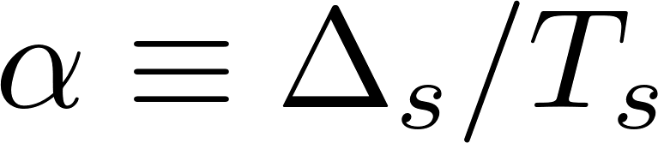
Requirements

Slide 12

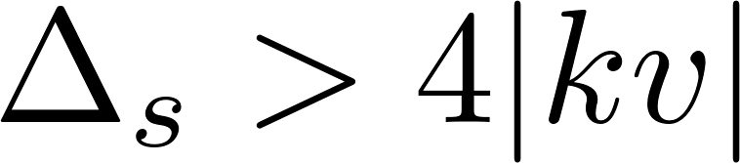
Requirements
Must begin sweep in :

Slide 13
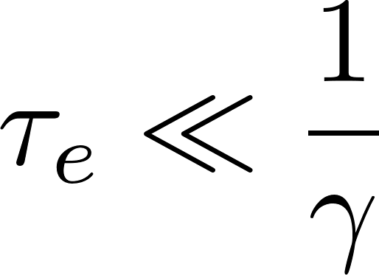

Requirements
Must begin sweep in :
Low decay probability during :

Slide 14
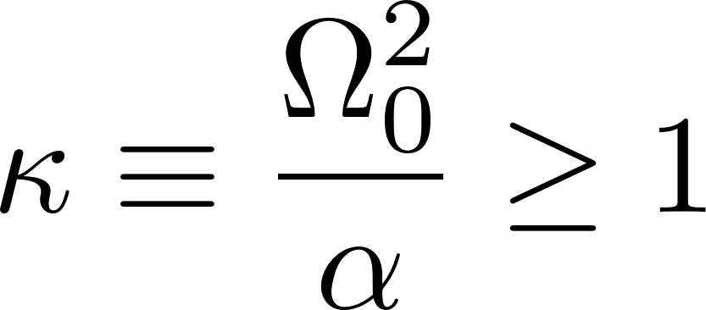
Requirements
Must begin sweep in :
Low decay probability during :
Large adiabatic transition probability:

Slide 15

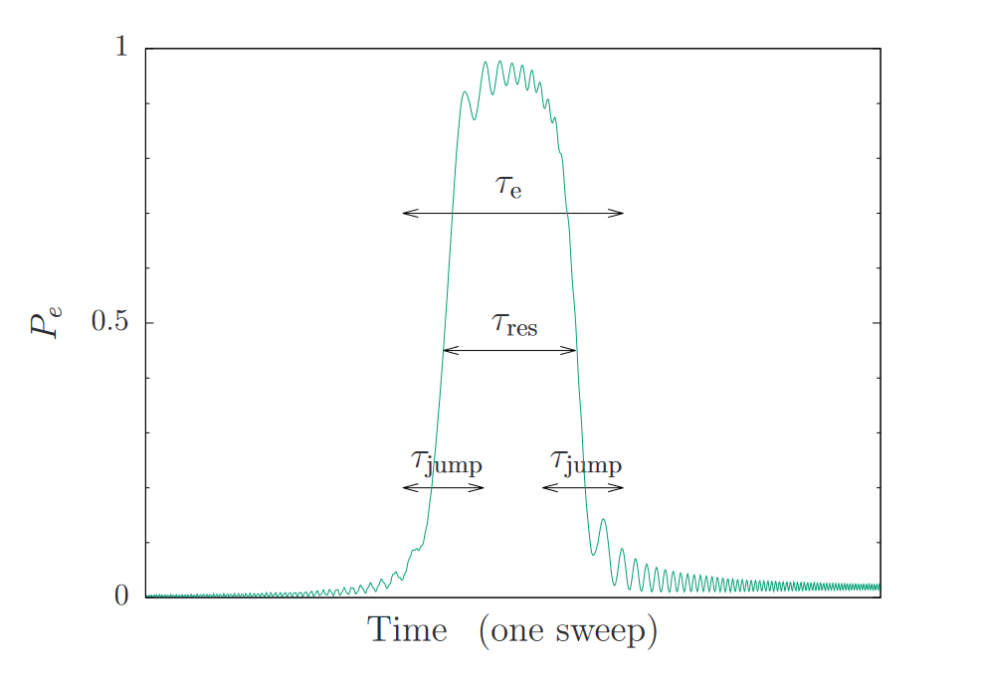
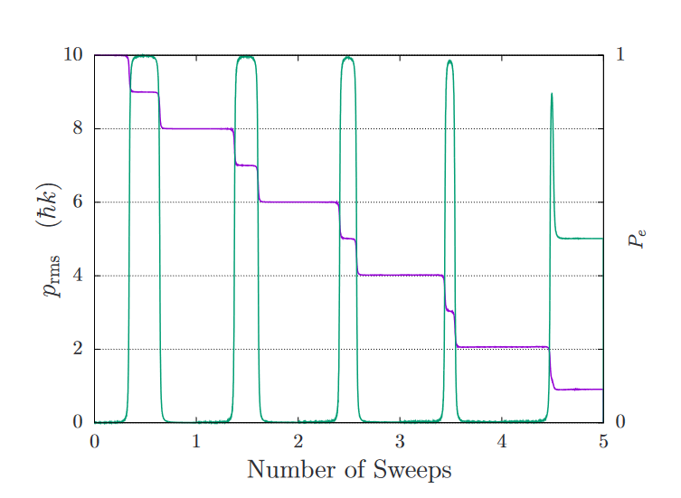
Validity
Particle interacts sequentially with one wave and then the other
→ Need sufficiently large

Slide 16
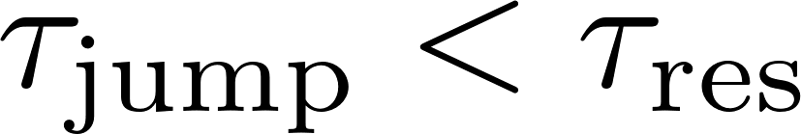
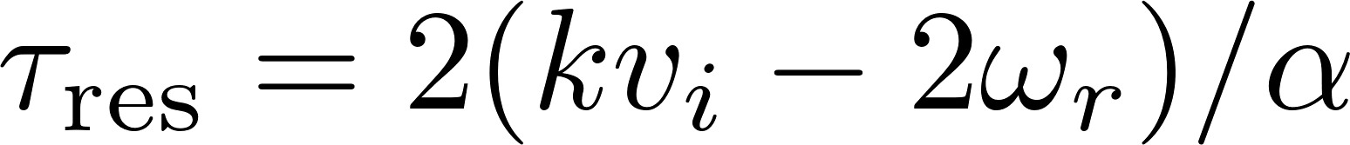

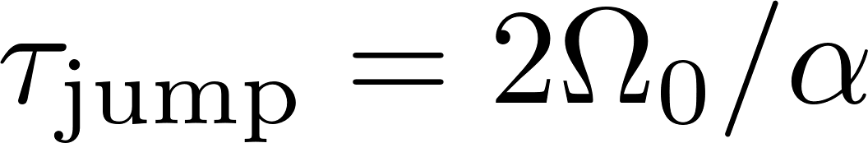
Validity
Particle interacts sequentially with one wave and then the other
→ Need sufficiently large
When adiabatic:
Valid if

Slide 17
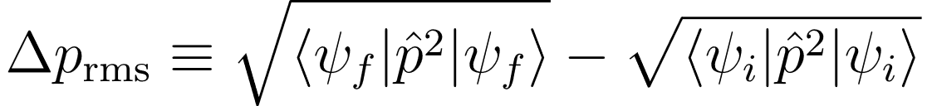
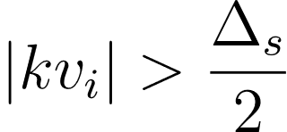
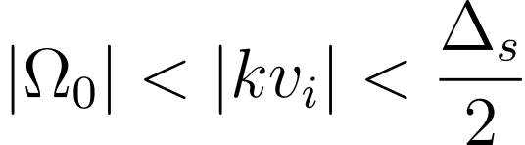

Forces and capture range
Conservative forces:
3 velocity regimes:
(0)
(1)
(2)
no interaction
high-v regime
more complicated…

Slide 18
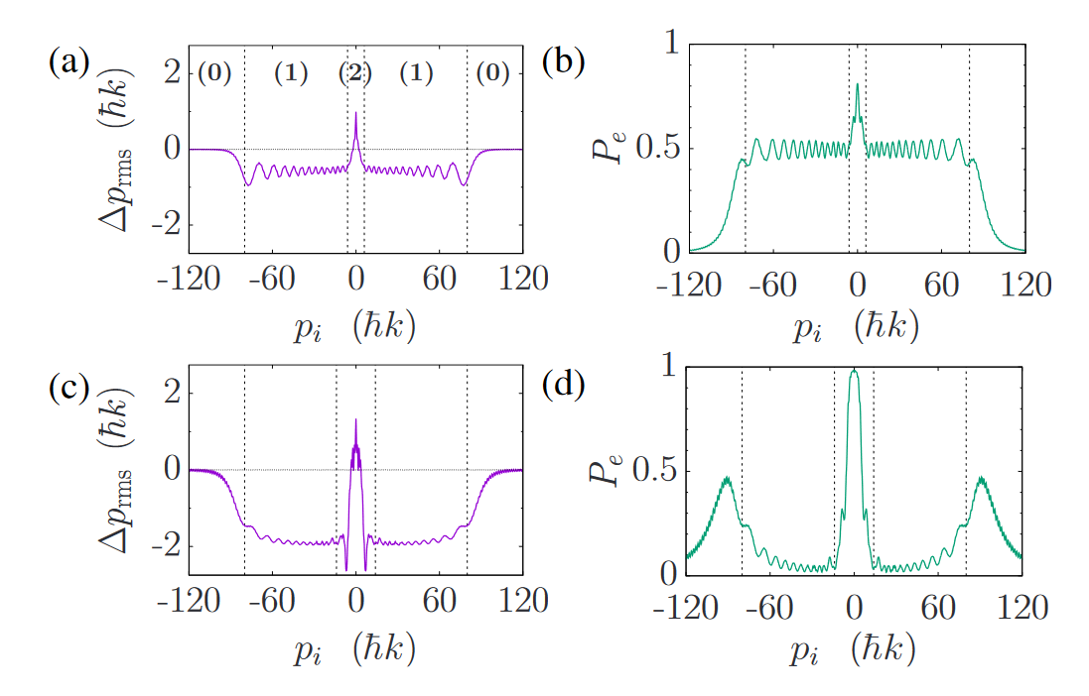
Forces and capture range
Conservative forces:
3 velocity regimes:
(0)
(1)
(2)
no interaction
high-v regime
more complicated…
diabatic
adiabatic

Slide 19
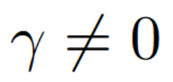
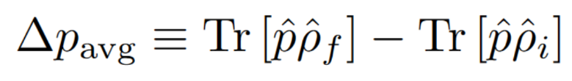
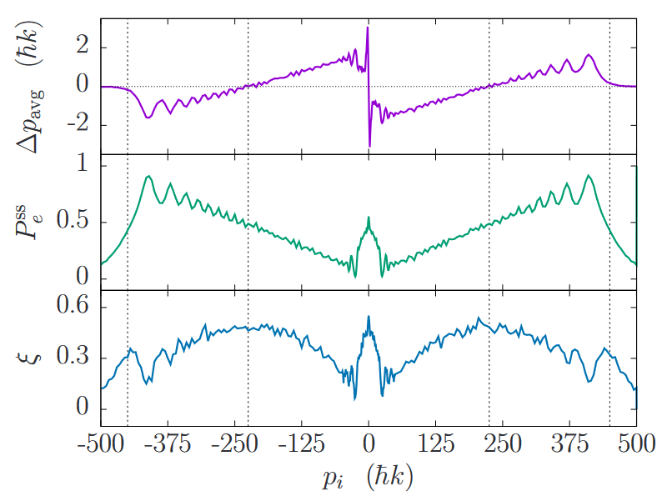
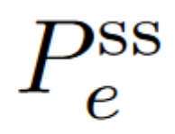
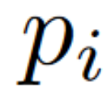

Forces and capture range
Forces with dissipation, ::
One sweep dynamics:
: steady-state population for each
: avg number of incoherent scattering events

Slide 20
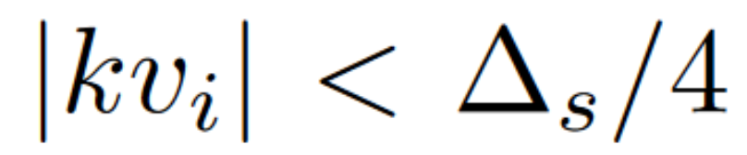
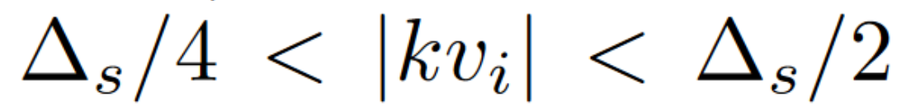
Forces and capture range
Forces with dissipation, ::
One sweep dynamics:
Impulse towards zero for
→ Capture range
Impulse away from zero for

Slide 21



Forces and capture range
Forces with dissipation, ::
One sweep dynamics:
Impulse of imparted for
Low scattering rate
Average force:
4 x scattering force at saturation
→ SWAP cools with low scattering rate + large forces

Slide 22
Forces and capture range
Forces with dissipation, ::
One sweep dynamics:
Impulse of imparted for
Low scattering rate
Average force:
4 x scattering force at saturation
→ SWAP cools with low scattering rate + large forces
complicated dynamics at low momentum:
Bragg oscillations, ambiguous time-ordering

Slide 23
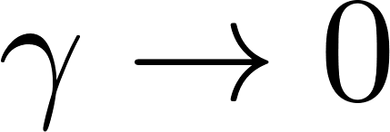
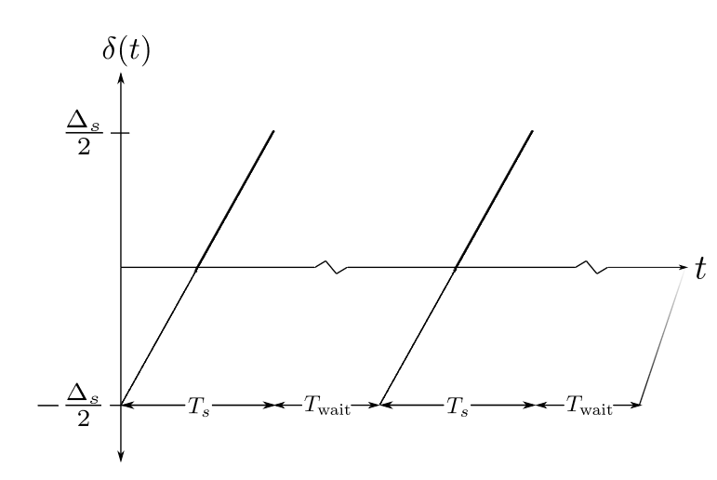
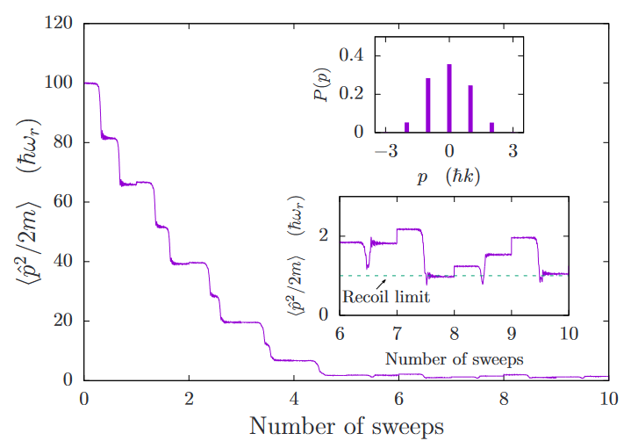




Temperature limit as
Sweep-wait scheme: mimics cooling process for particle with ultranarrow linewidth

Slide 24

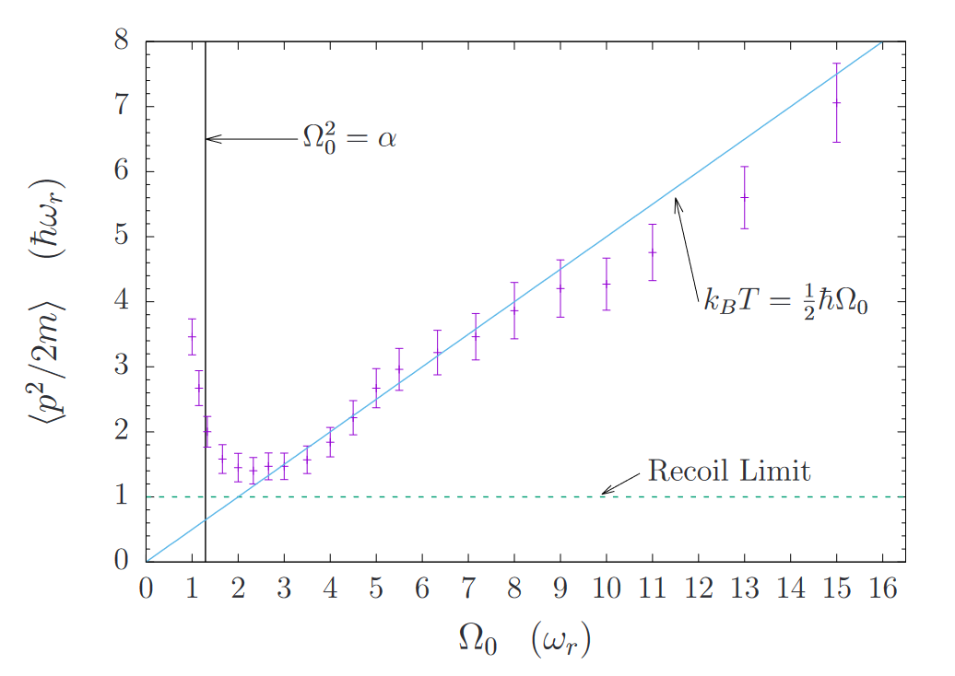
Temperature limit as
Scaling with :

Slide 25
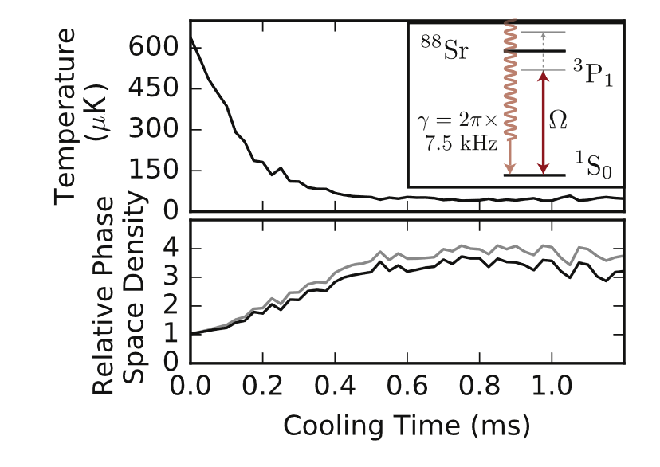
Application
7.5 kHz linewidth ¹S₀ to ³P₁ transition in ⁸⁸Sr
Norcia (2018), New J. Phys. 20-023021
Lowest temperature achieved: 2.3 µK
Doppler limit: 0.4 µK

Slide 26
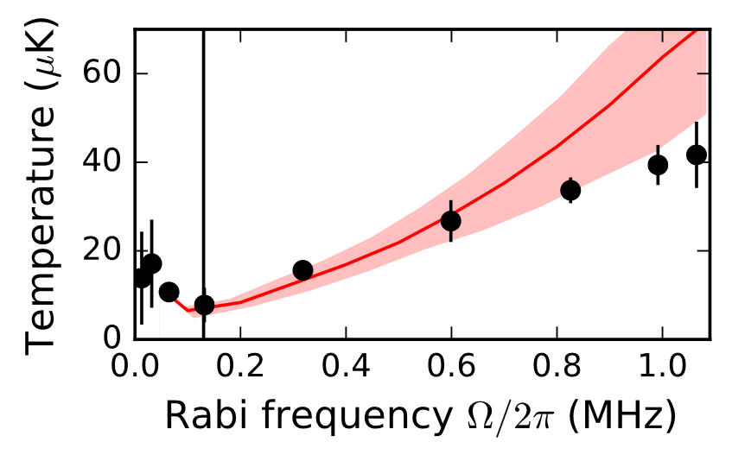
Application
7.5 kHz linewidth ¹S₀ to ³P₁ transition in ⁸⁸Sr
Norcia (2018), New J. Phys. 20-023021
Lowest temperature achieved: 2.3 µK
Doppler limit: 0.4 µK

Slide 27
Application
7.5 kHz linewidth ¹S₀ to ³P₁ transition in ⁸⁸Sr
Norcia (2018), New J. Phys. 20-023021
Cons: cannot achieve lowest possible temperature
Pros:
Strong forces on weak transitions
Large capture range
Reduced reliance on spontaneous emission
Lowest temperature achieved: 2.3 µK
Doppler limit: 0.4 µK

Slide 28

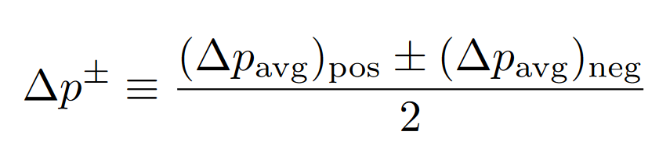
Forces and capture range
Forces with dissipation, ::
One sweep dynamics:
Bragg oscillations mix atom between
independent of sweep direction
Look at:
→ Effects present in (+), cancel in (-)
complicated dynamics at low momentum:
Bragg oscillations, ambiguous time-ordering

Slide 29
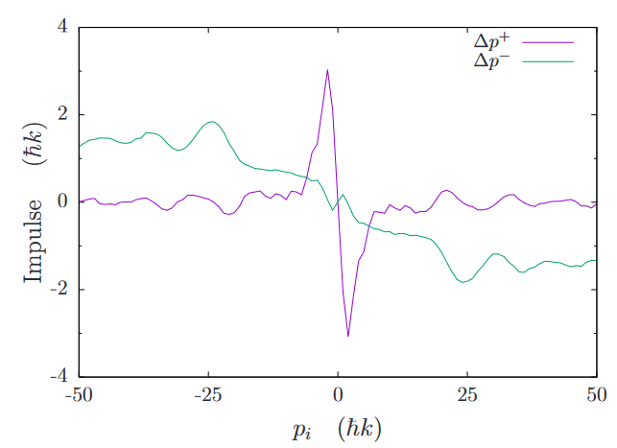
Forces and capture range
Forces with dissipation, ::
One sweep dynamics:
Bragg oscillations mix atom between
independent of sweep direction
Look at:
→ Effects present in (+), cancel in (-)

